Slide 1
Numerical Methods Lec 5
By
Asst. Prof. Syed Shujaat Hussain

Slide 2
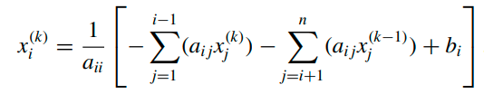
The Gauss-Seidel Method
. The components of x^{(k−1)} are used to compute all the components x_{i}^{(k)} of x^{(k)} . But, for i > 1, the components x₁^{(k)} , ... , x_{i-1}^{(k)} of x^{(k)} have already been computed and are expected to be better approximations to the actual solutions x₁, ... , x_{i−1} than are x₁^{(k−1)} , ... , x_{i-1}^{(k−1)}
This modification is called the Gauss-Seidel iterative technique

Slide 3
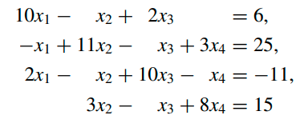

Q Use the Gauss-Seidel iterative technique to find approximate solutions to

Slide 4
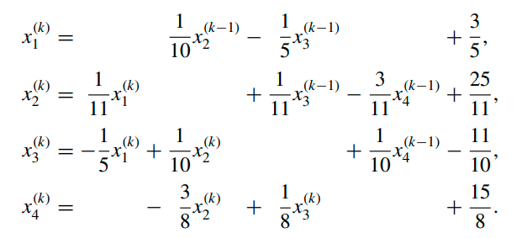
For the Gauss-Seidel method we write the system as
When x⁽⁰⁾ = (0, 0, 0, 0)^{t} , we have x⁽¹⁾ = (0.6000, 2.3272, −0.9873, 0.8789)^{t}

Slide 5
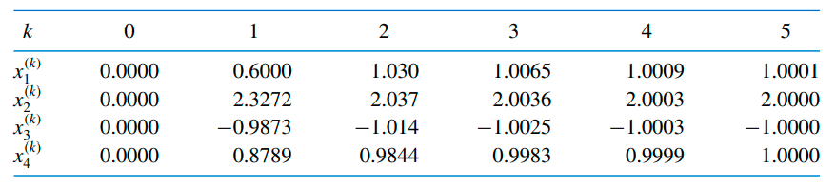

Subsequent iterations from Gauss seidel
We stopped after five iterations because

Slide 6
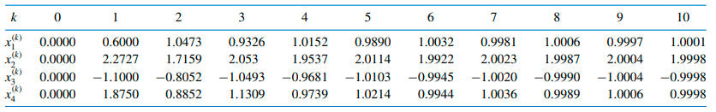
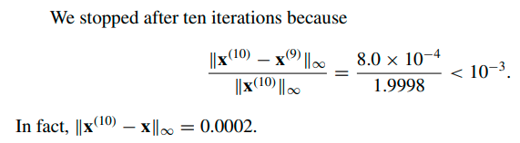
Note that same question with Jacobi’s method

Slide 7
Class Activity
Q: Solve system of Equation using Gauss Seidel method
27x + 6y – z = 85
6x +15y + 2z = 72
x + y + 54z = 110

Slide 8
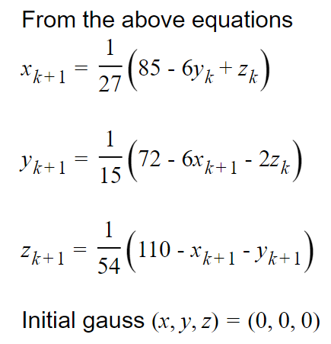
Solution
So

Slide 9
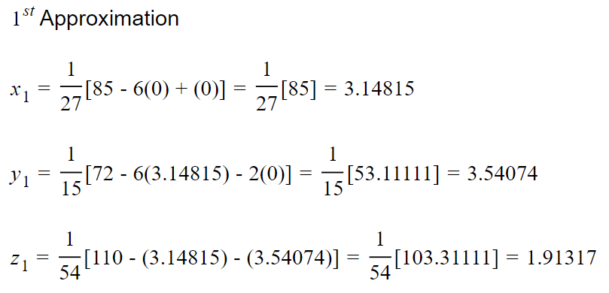
Solution
So

Slide 10
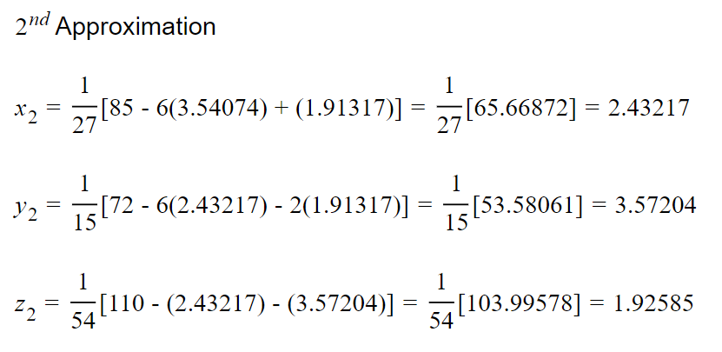
Solution
so

Slide 11
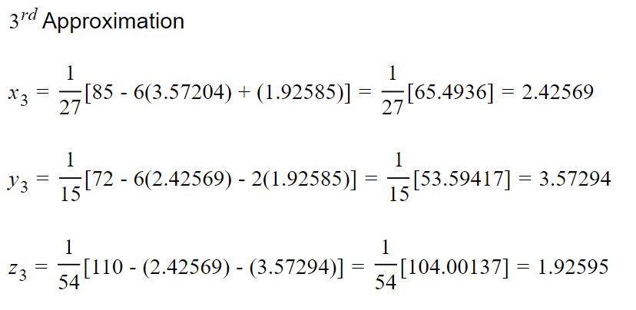
Solution
so

Slide 12
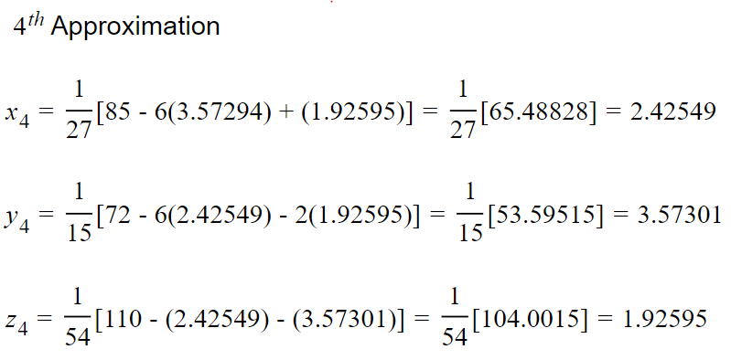
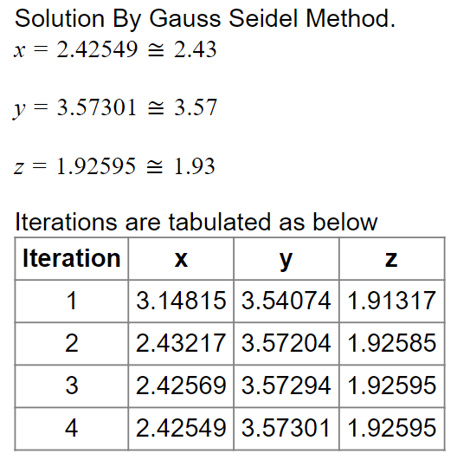
Solution
So

Slide 13
Class Activity
Q: Solve system of Equation using Gauss Seidel method
3x - y + z = 1
3x + 6y + 2z = 0
3x + 3y + 7z = 4

Slide 14

Solution

Slide 15

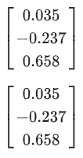

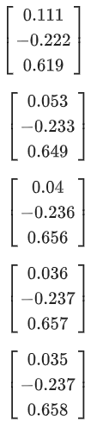
Solution

Slide 16
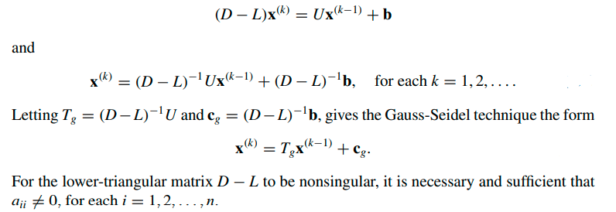
Gauss-Seidel method in Matrix form

Slide 17
Eigenvalues and Eigen vectors
For a nonzero vectors x parallel to Ax, we can write
Ax = λx
where λ is a constant and is called Eigenvalue
And x is called Eigenvector
so we have (A−λI)x = 0
If A is a square matrix, the characteristic polynomial of A is defined by
p(λ) = det(A − λI)

Slide 18

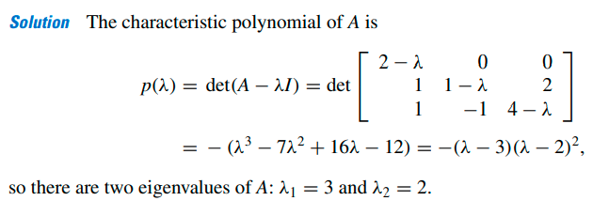
Q: Determine the eigenvalues for the matrix

Slide 19
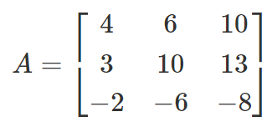
Class Activity
Q Determine the eigenvalues for the matrix

Slide 20

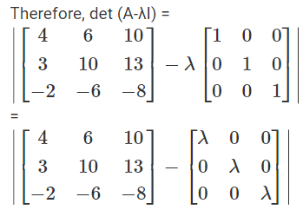
Solution
To find the Eigenvalues.

Slide 21
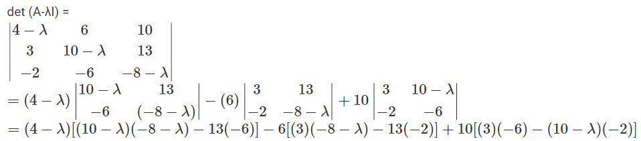
Solution
To find the Eigenvalues.

Slide 22


Solution
To find the Eigenvalues.

Slide 23


Solution
To find the Eigenvalues.

Slide 24

Test your ability!
Q. Determine the eigen values of A$= \begin{matrix}0 & −1 & 0 \\ 1 & 0 & 0 \\ 0 & 0 & 1\end{matrix}$

Slide 25



Solution
= 1
Your Eigen values are
In any eigen value =a+ib
“a” is Scaling factor and “b” reflects the rotation element.
The given matrix is of rotation of 90 degree about z axis.

Slide 26
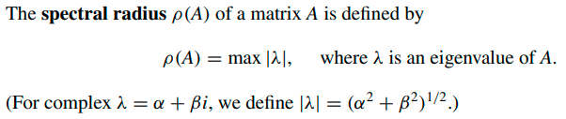
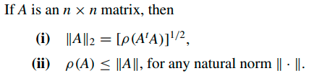
Spectral Radius
For the matrix considered in above Example
ρ(A) = max{2, 3} = 3.
The spectral radius is closely related to the norm of a matrix,

Slide 27
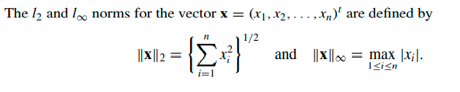
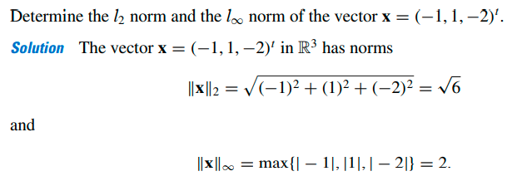
Vector Norms
Example :

Slide 28
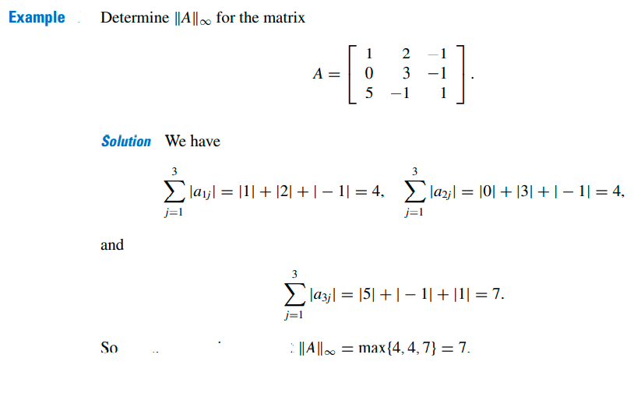
Infinite norm of a matrix

Slide 29
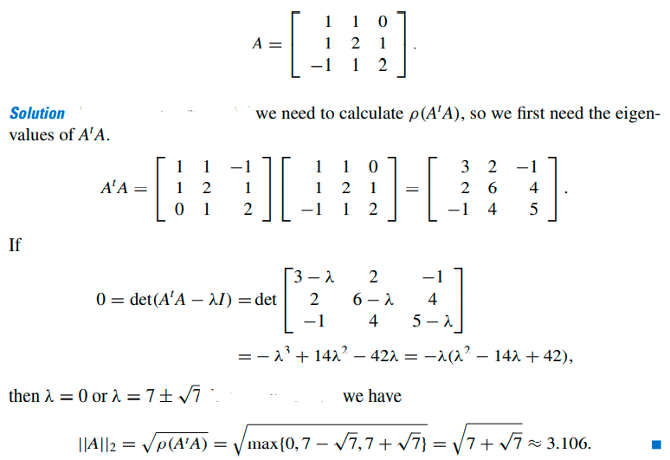
Q: Determine the l₂ norm of Matrix

Slide 30
Class Activity
Q Determine the l₂ norm of Matrix

Slide 31



Solution
$\begin{matrix}29 & 66 & 95 \\ 66 & 172 & 238 \\ 95 & 238 & 333\end{matrix}$
Continue working for L2 norm….

Slide 32

Solution
$\begin{matrix}29 & 66 & 95 \\ 66 & 172 & 238 \\ 95 & 238 & 333\end{matrix}$
Continue working for L2 norm….

Slide 33






Solution
$\begin{matrix}29 & 66 & 95 \\ 66 & 172 & 238 \\ 95 & 238 & 333\end{matrix}$
$\sqrt{530.43}$

Slide 34
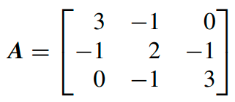
Test your ability!
Q Determine the l₂ norm of Matrix

Slide 35


Solution
$= \begin{matrix}10 & −5 & 1 \\ −5 & 6 & −5 \\ 1 & −5 & 10\end{matrix}$
Continue working for L2 norm…

Slide 36

Solution
$= \begin{matrix}10 & −5 & 1 \\ −5 & 6 & −5 \\ 1 & −5 & 10\end{matrix}$
Continue working for L2 norm…

Slide 37



Solution
$= \begin{matrix}10 & −5 & 1 \\ −5 & 6 & −5 \\ 1 & −5 & 10\end{matrix}$
$\sqrt{16}$

